Slide 1
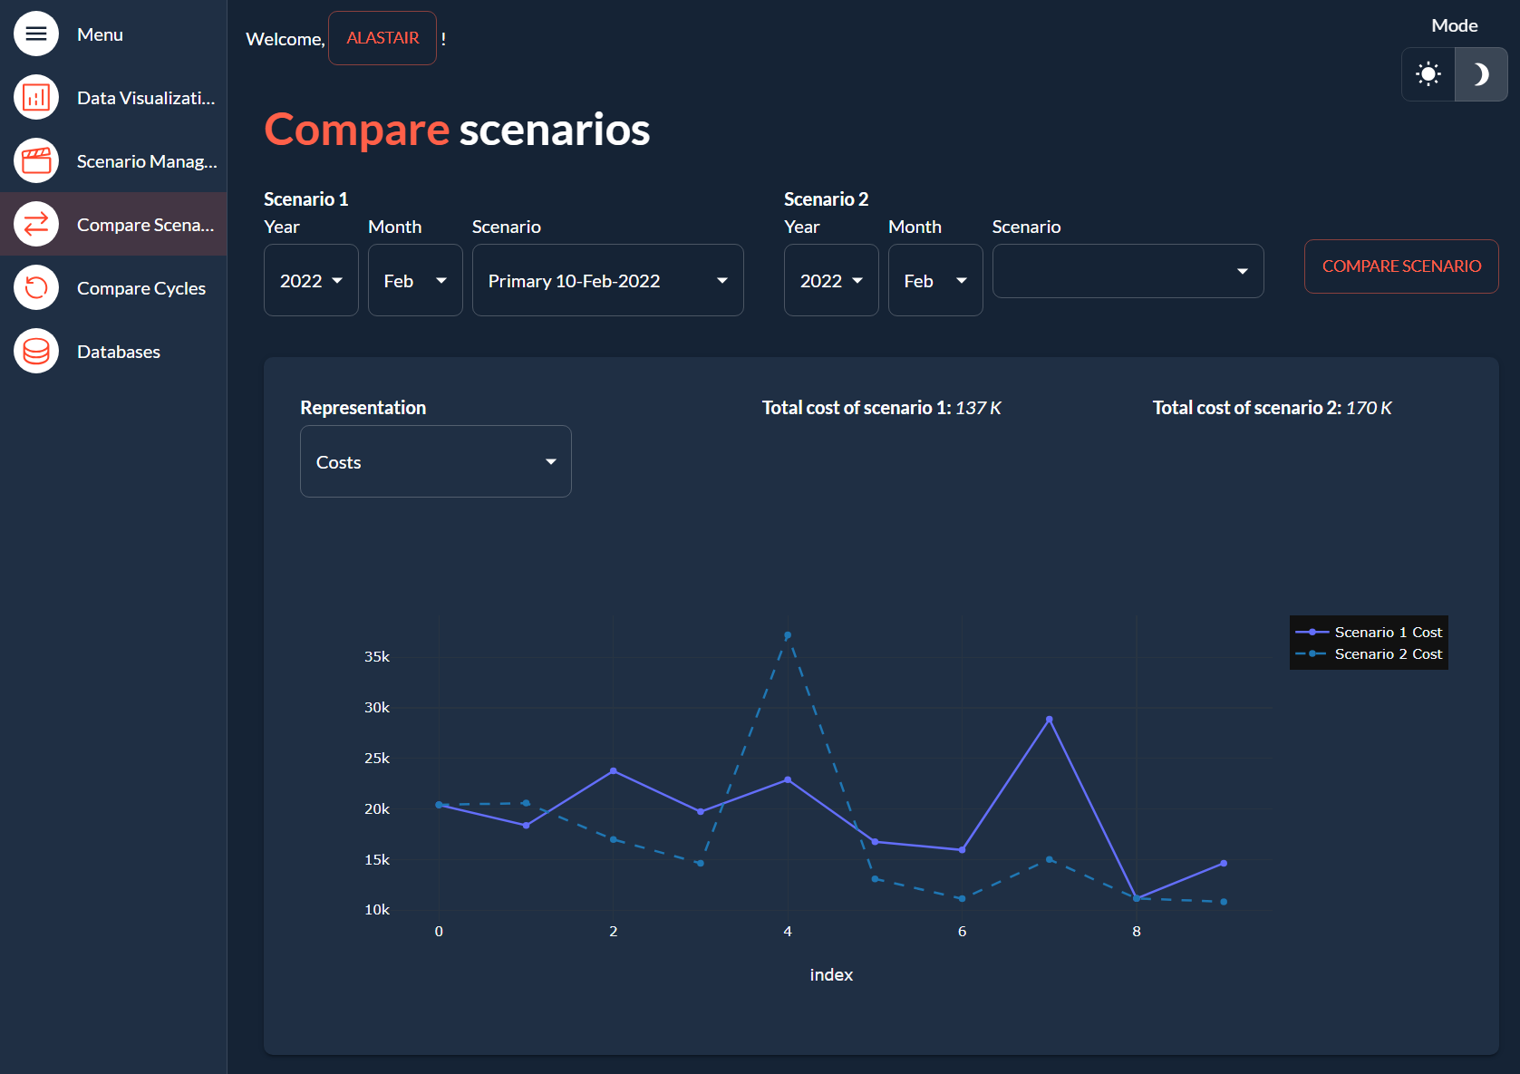
Assessments
Assessment
Assessment
Data Source
Location
Assessment type
Data Source
Location
Assessment type
FEA soln1
Weld 3
Scaled to Measurement
Field data1
1X
Scout data
*Add Assessment*
Data
Spectral
Time
fatigue damage
velocity

Slide 2
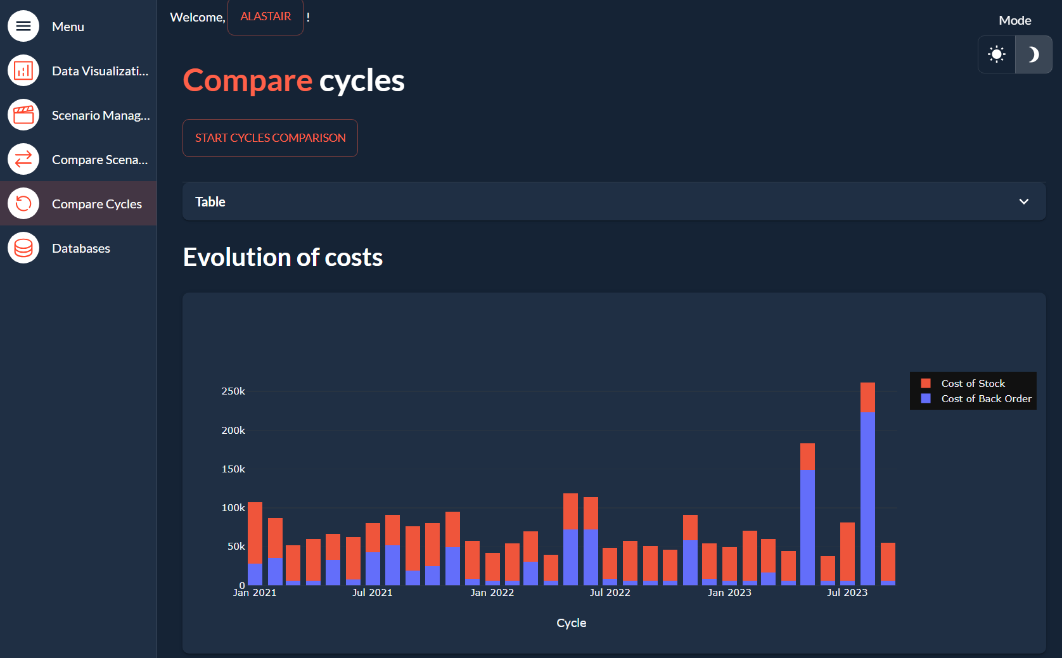
Data extraction
Extract results from Femap
Extraction options

Slide 3
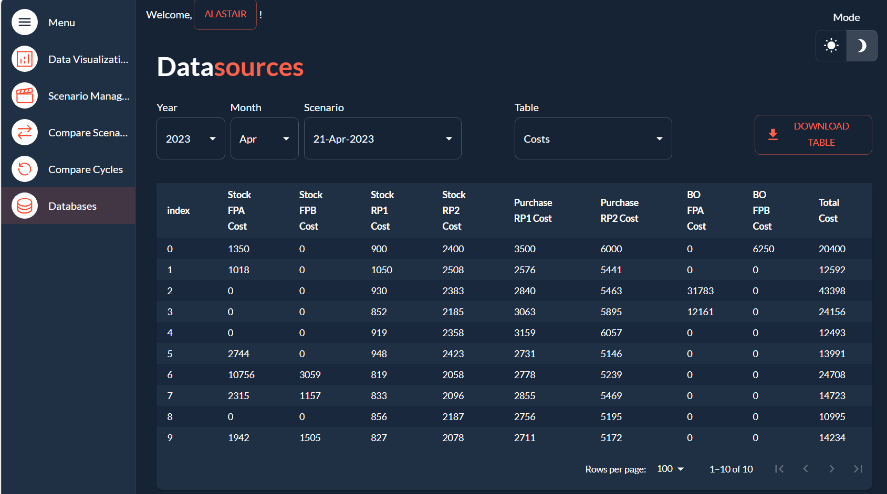
Model
Weld
Assessment type
Data
Soln1
Weld 3
Scaled to Measurement
Spectral/Time/fatigue

